Slide 1
Module 1 :
Agile and DevOps

Slide 2
Agile
DevOps
DevOps Role

Slide 3
DevOps
DevOps is a cultural and technical movement that breaks down silos between development and operations. It aims to enable faster, more reliable software delivery.
Goals:
Improve deployment frequency
Achieve faster time to market
Lower failure rates of new releases
Shorten lead time between fixes

Slide 4
Core DevOps Principles
Automation of build, test, and deployment
Continuous Integration / Delivery
Infrastructure as Code (IaC)
Monitoring & Feedback Loops
Collaboration and Shared Responsibility
Shift-Left Testing and Security

Slide 5
Module 2 :
Repository Management, Git workflow and Github

Slide 6
Repository
Repository is a central location which contains all your codes, Readme, all files, each files revision history. a cultural and technical movement that breaks down silos between development and operations. It aims to enable faster, more reliable software delivery.
Version Control tool.
Team can collaborate with each other.
Achieve quick development, ship, maintain, monitor the code.
Central vs distributed repository
Allow rollback
Enable working offline
Private vs Public
Local vs Remote

Slide 7
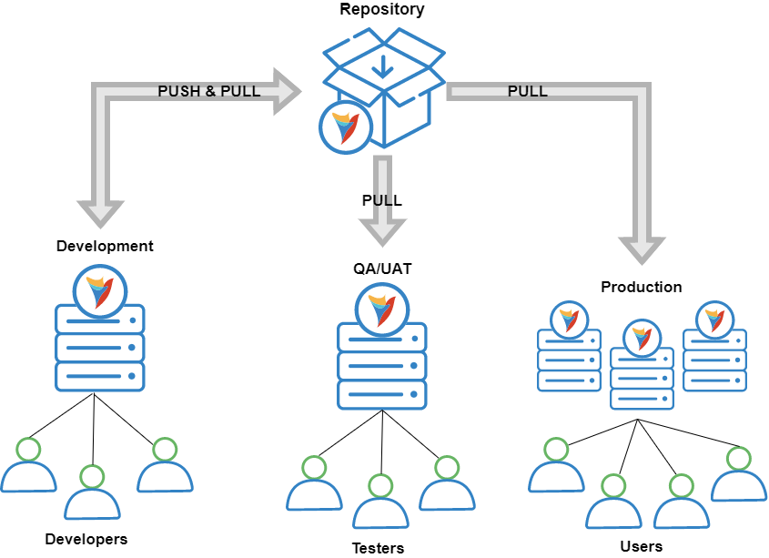

Slide 8


Slide 9
Repository Terminology
Branch
Clone
Fork
Merge
Pull request
Remote
Upstream
Commit
Push
Rebase
stash

Slide 10
Some Best Version Control Tools
1. New Relic — Best version control tool for version analysis
2. Datadog — Best for infrastructure and container monitoring
3. AWS CodeCommit — Best for collaborating on code and customizing user-specific access to your repositories
4. Flyway — Best tool for versioning your database
5. Subversion — Best centralized version control system for file locking and merge tracking
6. Git — Best free and open-source version control system
7. Rational ClearCase — Best for meeting compliance requirements
8. Unity Version Control — Best source control system for managing game development projects
9. Azure DevOps Server — Best tool for fostering collaboration among developers
10. CVS — Best for keeping a record of the history of sources files and documents

Slide 11
Different Type of Repository
1. Version Control Repositories
These are used to manage changes to code over time.
a. Git Repository
Most popular type of version control.
Supports distributed development.
Used by platforms like GitHub, GitLab, Bitbucket.
b. Subversion (SVN) Repository
Centralized version control system.
Less common today but still used in legacy systems.
c. Mercurial Repository
Another distributed version control system like Git.
Easier to learn but less popular than Git.

Slide 12
2. Code Hosting Repositories
These platforms host version control repositories and offer collaboration tools.
a. GitHub
Most popular platform.
Supports Git, issues, CI/CD, wikis, etc.
b. GitLab
Offers Git hosting with built-in CI/CD.
Can be self-hosted.
c. Bitbucket
Popular with enterprise teams.
Integrates with Atlassian tools (Jira, Trello).

Slide 13
3. Artifact Repositories
Used to store compiled binaries, libraries, or packages.
a. Maven Repository
For Java dependencies (e.g., Maven Central).
b. NuGet Repository
For .NET packages.
c. PyPI (Python Package Index)
For Python packages.
d. npm Registry
For Node.js (JavaScript) packages.
e. Docker Registry
For Docker images (e.g., Docker Hub, Amazon ECR).
f. JFrog Artifactory / Nexus Repository
Universal artifact repositories that support multiple languages.

Slide 14
4. Package Repositories (OS-level)
Used by operating systems to manage software installations.
a. APT (Debian/Ubuntu)
Advanced Package Tool (e.g., apt-get install).
b. YUM/DNF (Red Hat/CentOS/Fedora)
Package managers for RPM-based systems.
c. Homebrew (macOS)
For installing Unix tools on macOS.

Slide 15
5. Data Repositories
For storing and sharing datasets or research data.
Examples:
Kaggle Datasets
Zenodo
Figshare
Dataverse

Slide 16
6. Backup or Mirror Repositories
Mirrors of other repositories for redundancy or read-only access.
Examples: Git mirrors on GitHub or GitLab.

Slide 17
GitFlow
What is GitFlow?
Gitflow is a Git branching model designed to manage the development and release process of software projects. It was popularized by Vincent Driessen and uses a defined set of branches with specific roles and interactions to facilitate parallel development, controlled releases, and hotfixes.
Branches:
main (or master): This branch represents the official release history. Commits on this branch should always be stable and production-ready.
develop: This branch serves as the integration branch for all new features. All feature branches are typically branched off develop and merged back into it.
feature/*: These branches are created for developing new features or significant changes. They are branched from develop and merged back into develop upon completion.
release/*: These branches are created from develop when a new release is being prepared. They are used for final testing, bug fixes specific to the release, and versioning. Once stable, they are merged into both main and develop.
hotfix/*: These branches are created directly from main to address critical bugs in a production release. Once the fix is implemented and tested, they are merged into both main and develop.

Slide 18
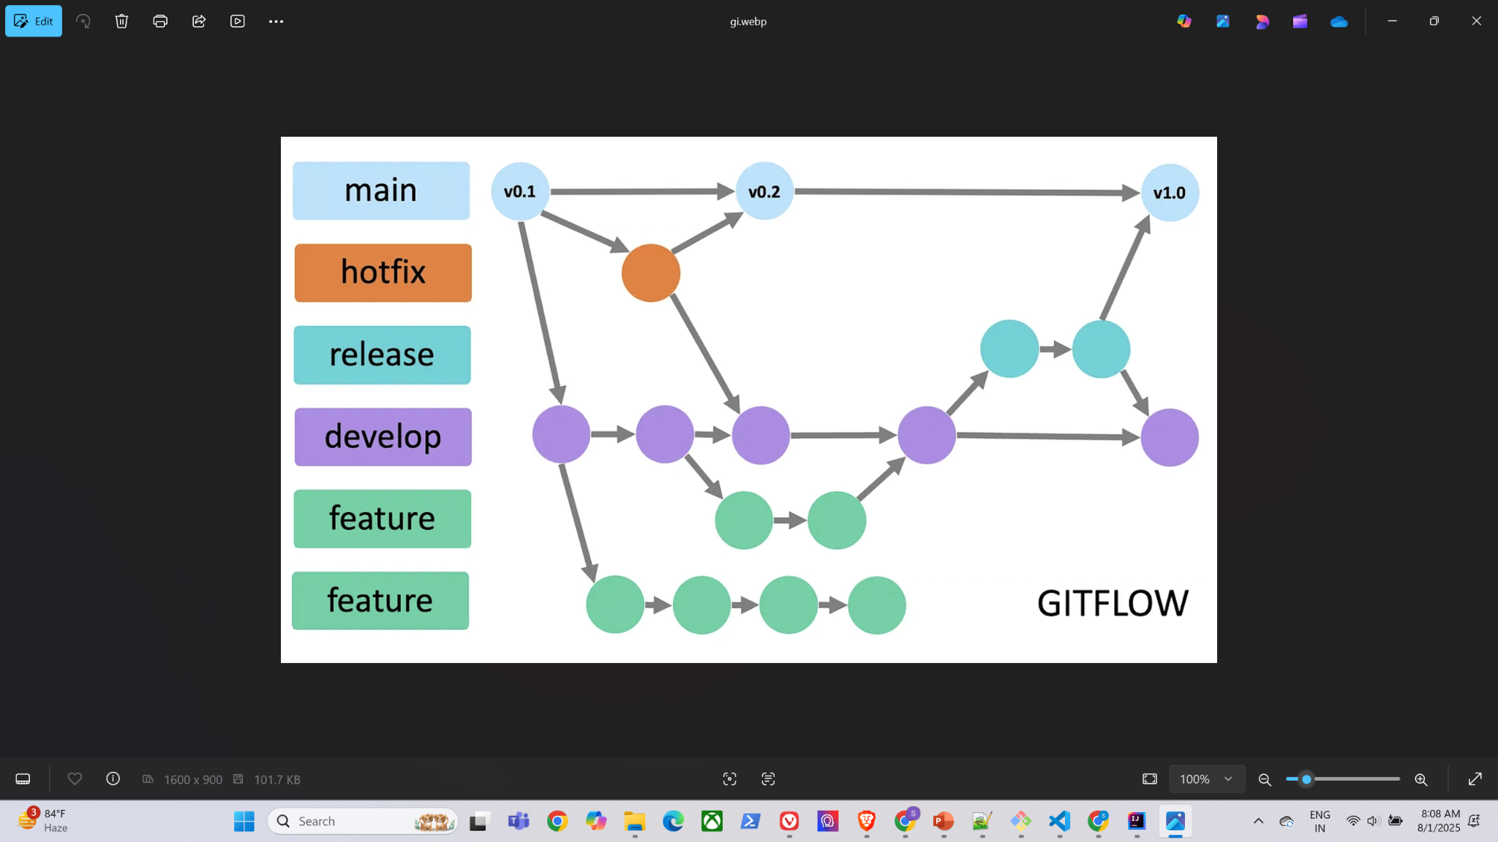

Slide 19
Git Commands:
git init
Initialize a local Git repository
git clone ssh://git@github.com/[username]/[repository-name].git
Create a local copy of a remote repository
git status
Check status

Slide 20
User Info Config:
Configuring user information used across all local repositories
SET NAME
git config --global user.name “[firstname lastname]” set a name that is identifiable for credit when review version history
SET EMAIL
git config --global user.email “[valid-email]” set an email address that will be associated with each history marker
SET COMMAND LINE COLORING
git config --global color.ui auto set automatic command line coloring for Git for easy reviewing

Slide 21
git add [file-name.txt]
Add a file to the staging area
git add -A
Add all new and changed files to the staging area
git commit -m "[commit message]"
Commit changes
git rm -r [file-name.txt]
Remove a file (or folder)
git remote -v
View the remote repository of the currently working file or directory

Slide 22
git branch
List branches (the asterisk denotes the current branch)
git branch -a
List all branches (local and remote)
git branch [branch name]
Create a new branch
git branch -d [branch name]
Delete a branch
git push origin --delete [branch name]
Delete a remote branch
git checkout -b [branch name]
Create a new branch and switch to it
git checkout -b [branch name] origin/[branch name]
Clone a remote branch and switch to it

Slide 23
git branch -m [old branch name] [new branch name]
Rename a local branch
git checkout [branch name]
Switch to a branch
git checkout -
Switch to the branch last checked out
git checkout -- [file-name.txt]
Discard changes to a file
git merge [branch name]
Merge a branch into the active branch
git merge [source branch] [target branch]

Slide 24
Merge a branch into a target branch
git stash
Stash changes in a dirty working directory
git stash clear
Remove all stashed entries
git stash pop
Apply latest stash to working directory
git push origin [branch name]
Push a branch to your remote repository
git push -u origin [branch name]
Push changes to remote repository (and remember the branch)
git push
Push changes to remote repository (remembered branch)
git push origin --delete [branch name]
Delete a remote branch

Slide 25
git pull
Update local repository to the newest commit
git pull origin [branch name]
git log
View changes
git log --summary
View changes (detailed)
git log --oneline
View changes (briefly)
git diff [source branch] [target branch]
Preview changes before merging

Slide 26
Workflow Overview:
Start a new feature: Create a feature branch from develop.
Develop the feature: Work on the feature within its dedicated branch.
Integrate the feature: Merge the feature branch back into develop.
Prepare a release: Create a release branch from develop.
Finalize the release: Perform testing and bug fixes on the release branch.
Release: Merge the release branch into main and develop.
Hotfix: If a critical bug is found in production, create a hotfix branch from main, fix the bug, and merge it back into main and develop.
Advantages:
Provides a structured and predictable release cycle.
Facilitates parallel development by isolating feature work.
Clearly separates development from releases and hotfixes.
Disadvantages:
Can be more complex than simpler models like GitHub Flow, especially for smaller teams or projects aiming for continuous delivery.
Requires strict adherence to the branching pattern to be effective.

Slide 27
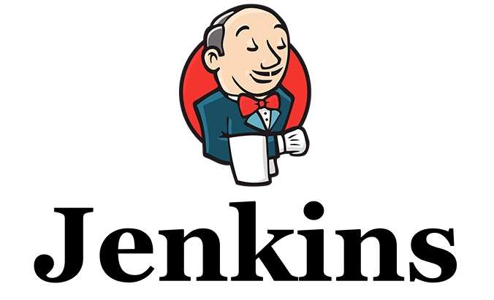
Jenkins

Slide 28
Jenkins:
Jenkins is a self-contained, open source automation server which can be used to automate all sorts of tasks related to building, testing, and delivering or deploying software.
Jenkins can be installed through native system packages, Docker, or even run standalone by any machine with a Java Runtime Environment (JRE) installed.

Slide 29
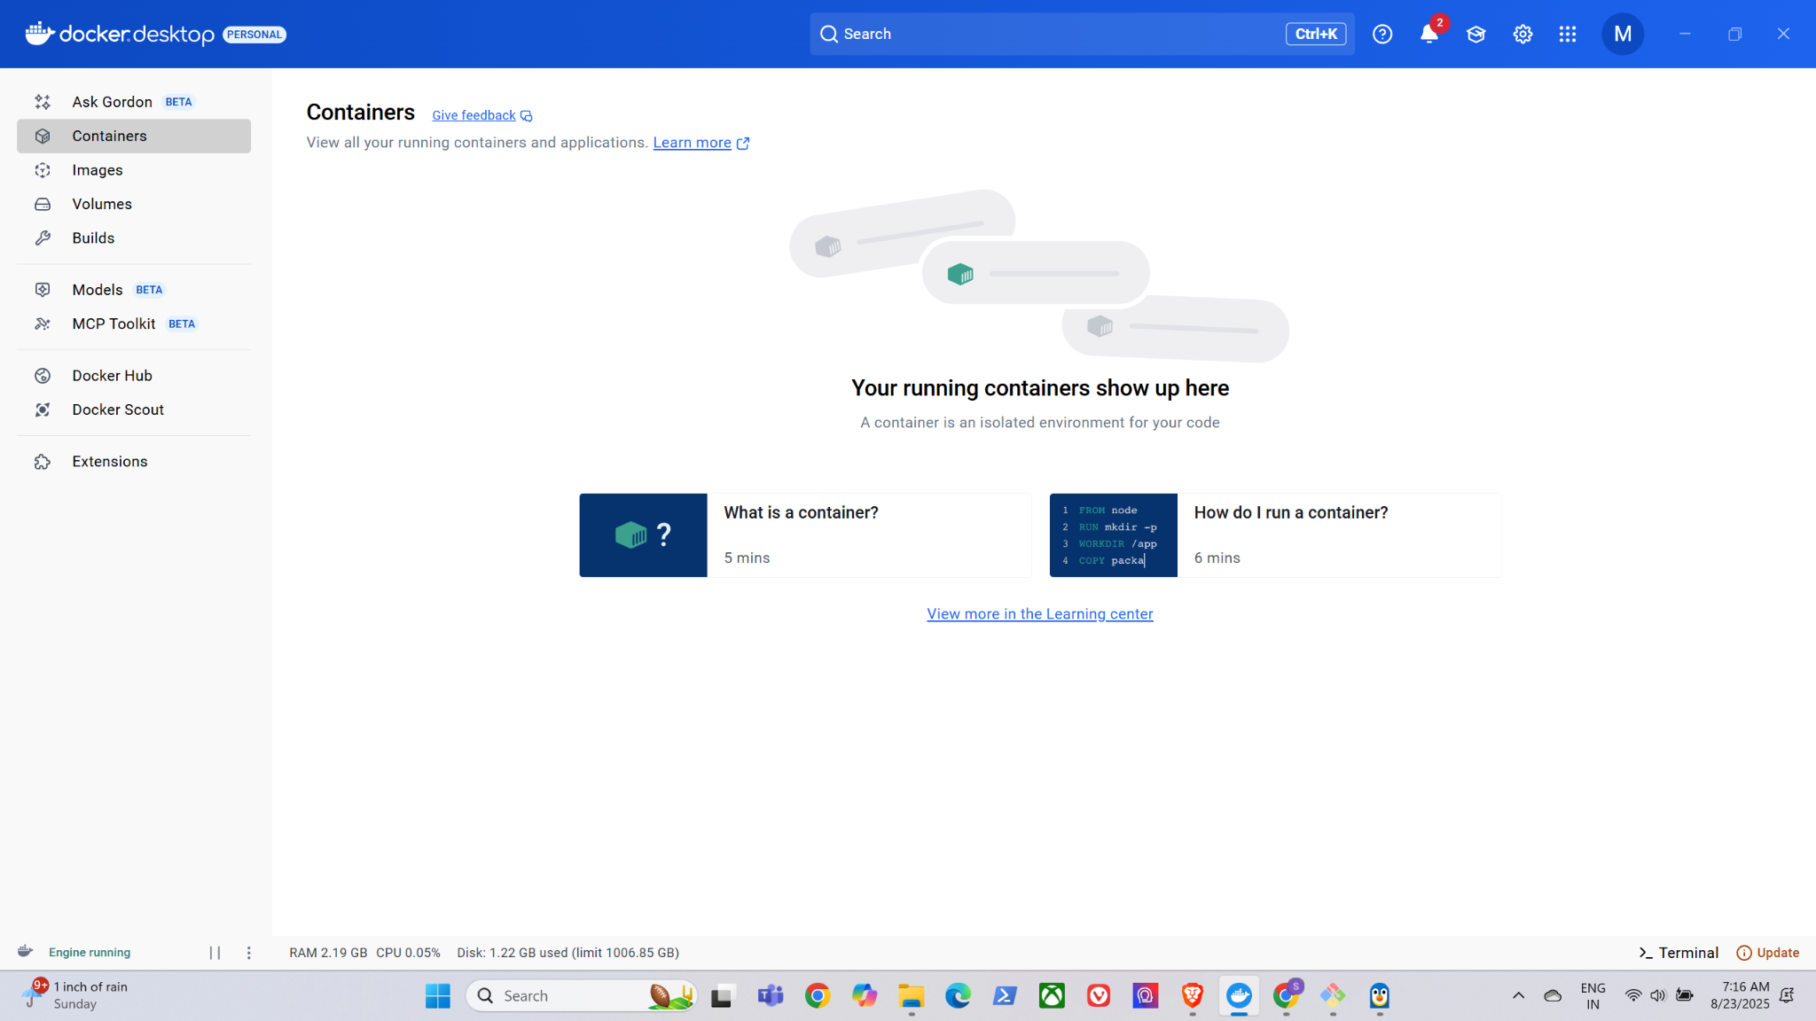
Docker Installation:
Install Docker [ https://docs.docker.com/desktop/setup/install/windows-install/ ]
wsl.exe --install

Slide 30
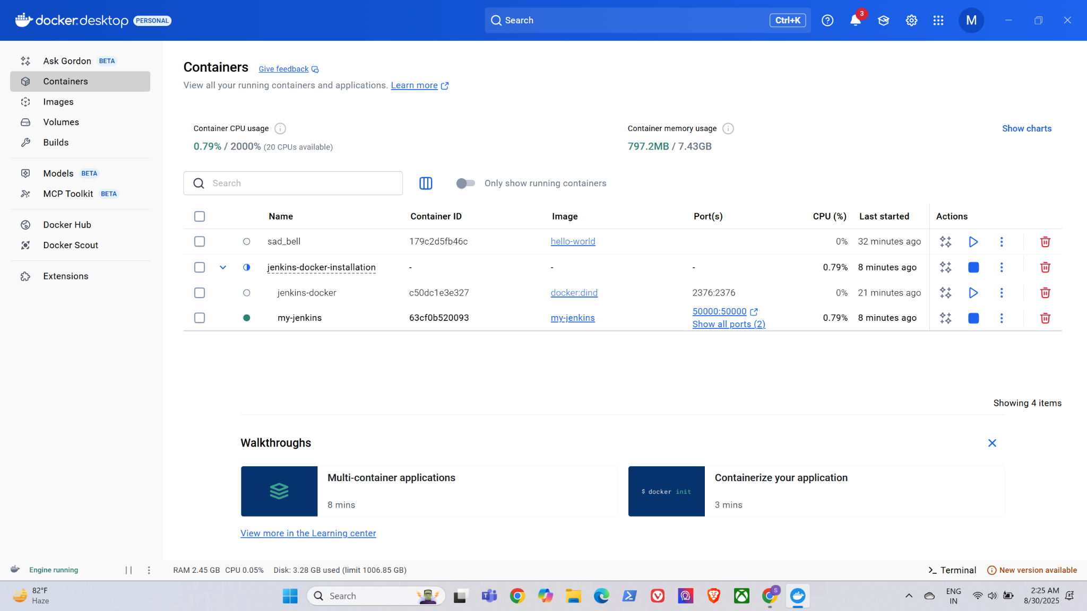

Slide 31

Jenkins Installation:
Follow steps from https://github.com/gec-training/Devops/tree/main/jenkins-docker-installation

